Slide 1


Slide 2
Particle Physics Event Classification
A Machine Learning Project
INDIVIDUAL PROJECT BY:
Vatsal Shah
vatsal793@gmail.com

Slide 3

Problem Description
In the field of particle physics, accurate identification and classification of events are crucial for understanding fundamental particles and their interactions.
The goal of this project is to build a machine learning model that can classify events as either signal (s) or background (b).
This classification will help distinguish between events of interest (signal) and background noise, contributing to the advancement of research in particle physics.

Slide 4
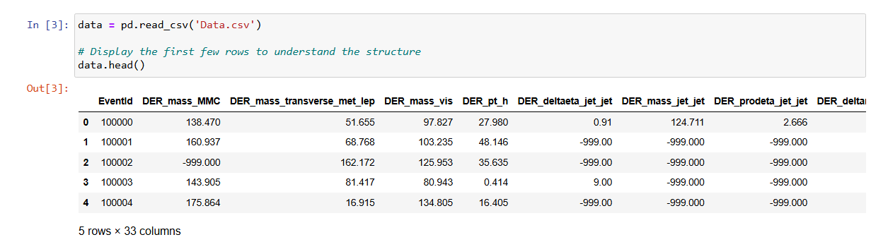
Dataset Overview
The dataset consists of 250,001 rows and 33 columns. Each row represents an event, and the columns contain features derived from particle physics experiments.
The dataset contains features related to particle physics events, including kinematic properties of the particles. The target variable (Label) indicates whether an event is signal (s) or background (b).

Slide 5
Approach
1. Data Preprocessing:
Handling missing values, normalization, and feature selection.
2. Exploratory Data Analysis (EDA):
Analyzing the distribution of features and their relationship with the target variable.
3. Model Building:
Training machine learning models to classifying events.
4. Model Evaluation:
Using metrics like accuracy, precision, recall, and ROCAUC to evaluate performance.
5. Conclusion & Recommendations:
The model achieved perfect classification, highlighting the effectiveness of Random Forest, with future enhancements suggested for realtime applications and expanded feature exploration.

Slide 6
Data Preprocessing
1. Handling Missing Values:
Checked for placeholder values like -999 and missing entries in the dataset.
Dropped columns with more than 50% missing values.
Imputed missing values in numeric columns using the median.
2. Feature Encoding:
Encoded the target variable ('Label') into a binary format (`1` for signal, `0` for background).
Removed the original 'Label' column after encoding.
3. Correlation Analysis:
Separated the dataset into features (X) and target (y).
Applied an 80-20% split to create training and testing sets.
4. Handling Class Imbalance:
Applied SMOTE (Synthetic Minority Oversampling Technique) to address class imbalance in the dataset.

Slide 7
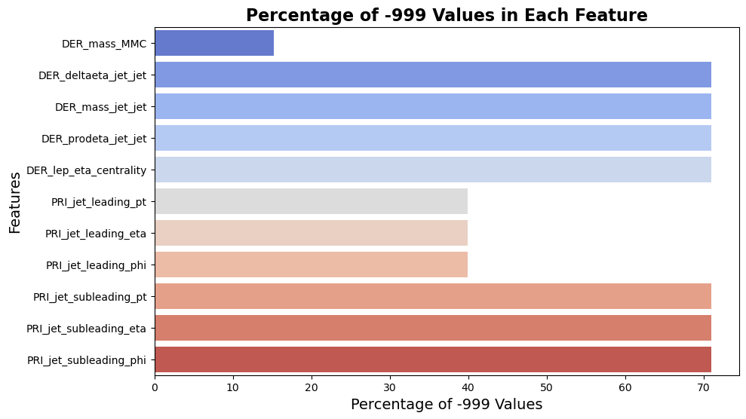
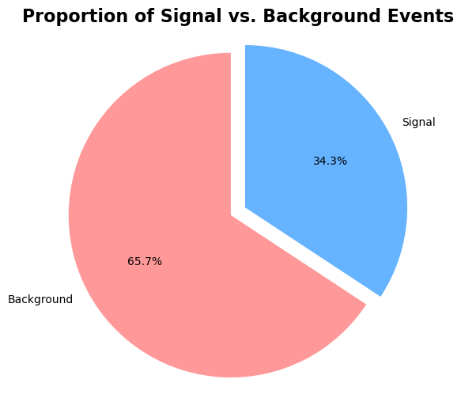
1. Handling Missing Values:
Features like DER_mass_MMC and DER_deltaeta_jet_jet had over 60% missing values, making them significant targets for imputation or removal during preprocessing.
2. Class Imbalance:
There is a significant class imbalance between signal and background events (34.3% vs. 65.7%).

Slide 8
Exploratory Data Analysis
1. Feature Distribution:
Analyzed the distribution of key numerical features (e.g., `DER_mass_MMC`, `PRI_tau_pt`) to understand their spread and detect potential anomalies.
2. Correlation Analysis:
Computed and visualized the correlation matrix to identify significant relationships between features.
Helped in understanding feature interdependencies and selecting important features for model building.
3. Target Variable Analysis:
Visualized the distribution of the target variable to assess class imbalance.
Found that the dataset was imbalanced, with more background events than signal events.
4. Class Imbalance:
Identified the need to address class imbalance, leading to the application of SMOTE during data preprocessing.

Slide 9
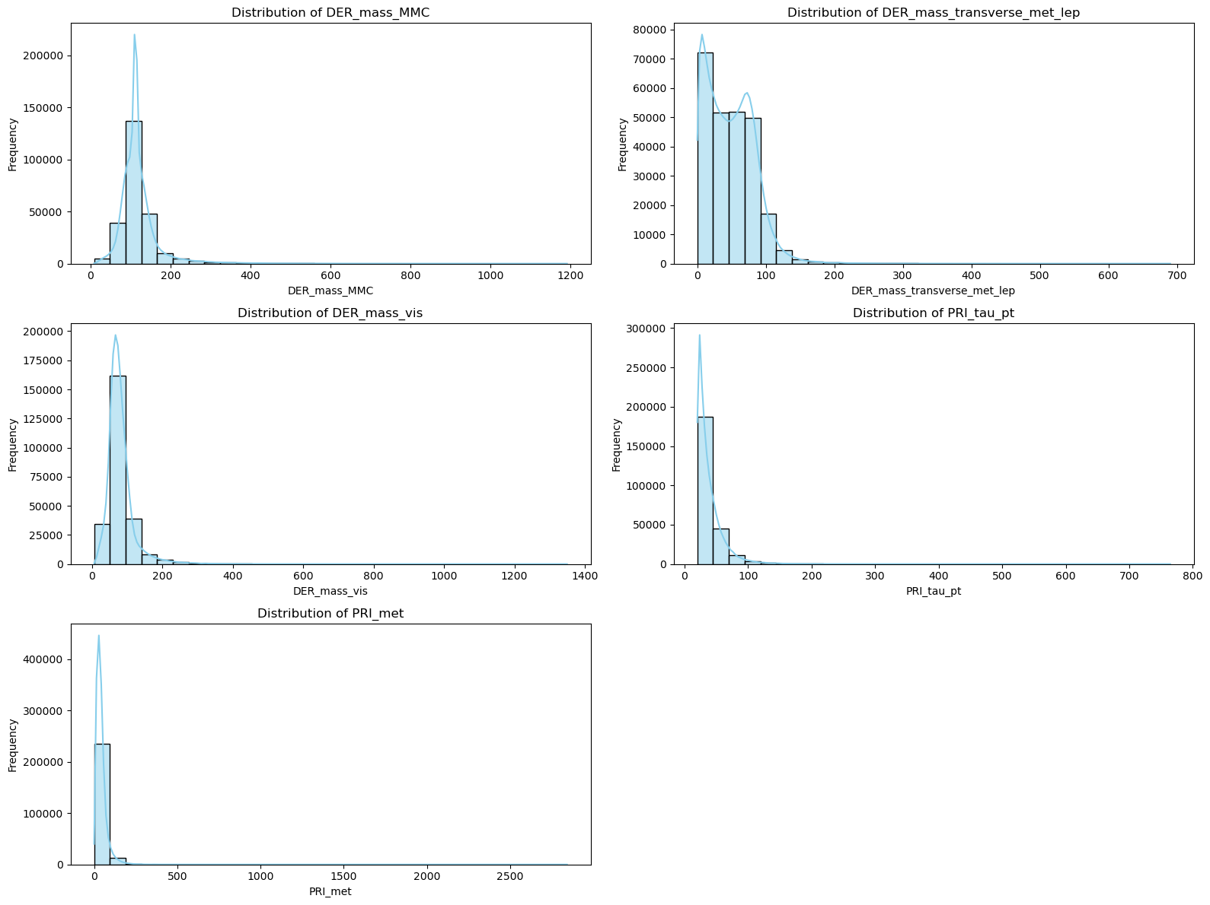

Slide 10
Exploratory Data Analysis Feature Distributions
Feature Insights:
DER_mass_MMC: Shows a right-skewed distribution with most values clustering towards the lower end. This suggests that most events have a relatively lower combined mass.
DER_mass_transverse_met_lep: Also right-skewed, indicating that the majority of events have a low transverse mass when considering missing transverse energy and lepton information.
DER_mass_vis: Similar to `DER_mass_MMC`, this feature has a high concentration of lower values, indicating that most events have a smaller visible mass.
PRI_tau_pt: The distribution is highly skewed towards lower values, suggesting that the transverse momentum of the tau particle is generally low in the dataset.
PRI_met: Displays a heavy right tail, indicating that while most events have low missing transverse energy, there are a few events with significantly higher values.
Conclusion: These distributions highlight that several key features exhibit skewness, implying the need for appropriate preprocessing steps such as normalization or transformation to ensure effective model training.

Slide 11
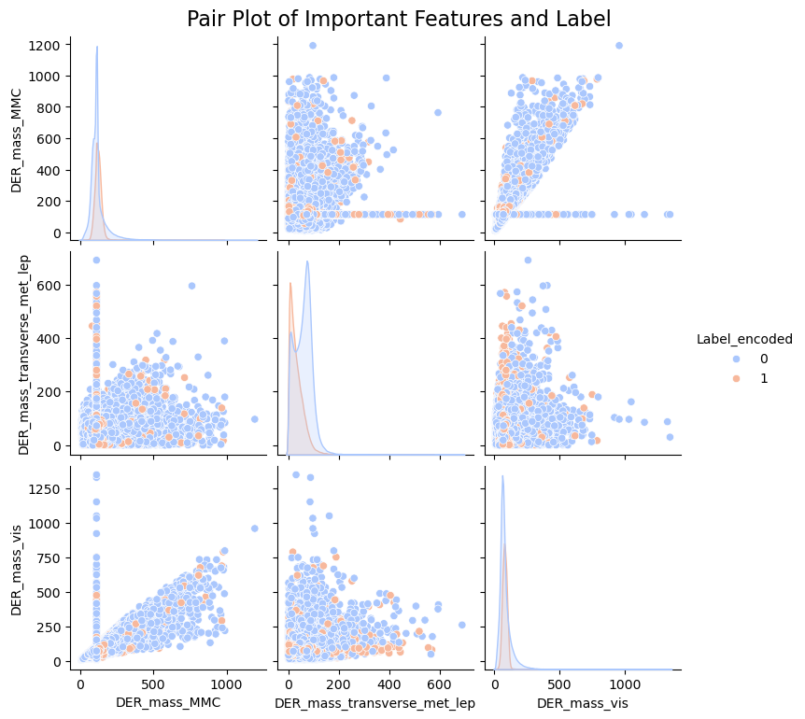

Slide 12
Correlation Heatmap
DER_mass_MMC and DER_mass_transverse_met_lep also show a negative correlation with the Label_encoded target variable.
Overview: This heatmap visualizes the correlation between different features in the dataset, showing how they relate to one another. The color intensity indicates the strength and direction of the correlation, with red representing positive correlations and blue representing negative correlations.
Key Insights:
Strong Positive Correlations:
DER_mass_MMC and DER_mass_vis show a strong positive correlation, indicating that events with a higher visible mass also tend to have a higher combined mass.
PRI_met and PRI_met_sumet also exhibit a strong positive correlation, suggesting that these features capture related aspects of the event's energy.
Strong Negative Correlations:
PRI_jet_num and PRI_met_phi display a notable negative correlation, indicating an inverse relationship between the number of jets and the missing transverse energy's direction.
Most features exhibit weak correlation with the target variable (Label_encoded), however, the Weight feature has a strong negative correlation with Label_encoded, as shown by the dark blue color.

Slide 13
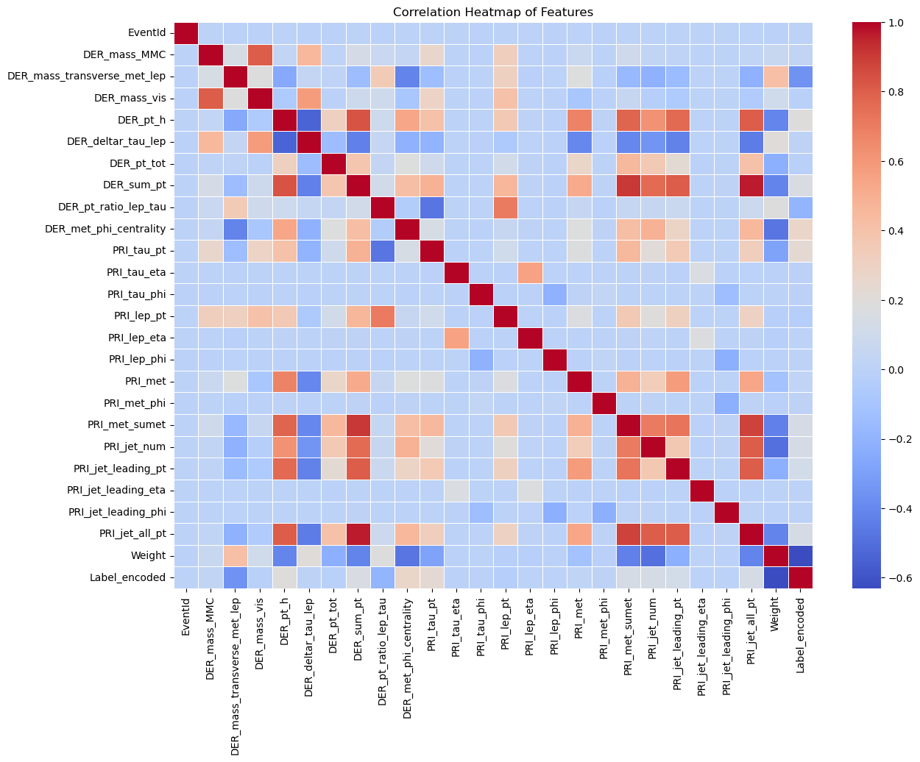

Slide 14
Class Distribution Before and After SMOTE
The graphs depict the distribution of the target variable (Class 0 = Background, Class 1 = Signal) before and after applying the Synthetic Minority Over-sampling Technique (SMOTE) to address class imbalance.
Before SMOTE:
The dataset was imbalanced, with a significantly higher number of background events (Class 0) compared to signal events (Class 1).
This imbalance could lead to biased model performance, favoring the majority class during classification.
After SMOTE:
SMOTE was applied to oversample the minority class (signal events) to create a balanced dataset.
Both classes now have an equal count, ensuring that the model receives a balanced representation of both event types during training.
Conclusion: Addressing class imbalance using SMOTE helps improve model performance by preventing it from being biased toward the majority class, thereby enhancing the model's ability to accurately classify both background and signal events.

Slide 15
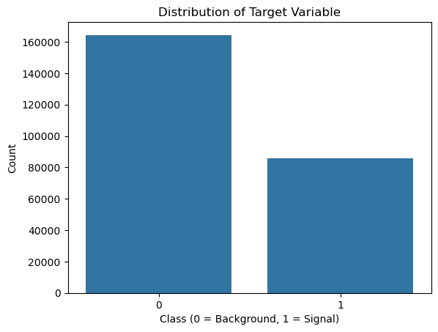
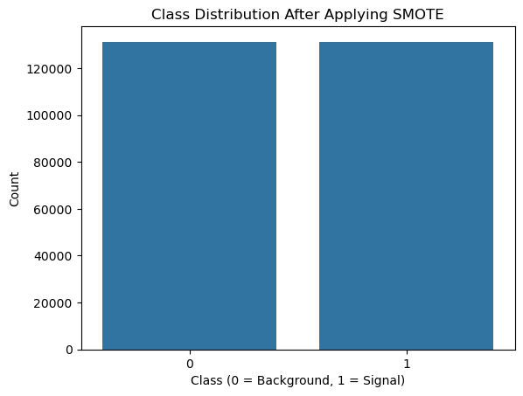
Before SMOTE
After SMOTE

Slide 16
Feature Engineering
Weight: Dominates feature importance, indicating its critical role in classifying particle physics events.
DER_mass_MMC: Represents the combined mass of detected particles, a key feature in identifying event characteristics.
DER_mass_transverse_met_lep: Provides insight into the event's energy distribution, aiding in distinguishing between signal and background.
DER_mass_vis: Captures the visible mass of the event, helping to differentiate signal events.PRI_tau_pt: Indicates the transverse momentum of the tau particle, crucial for understanding particle interactions.
DER_met_phi_centrality: Measures the centrality of the missing transverse energy, contributing to the event's spatial configuration analysis.

Slide 17
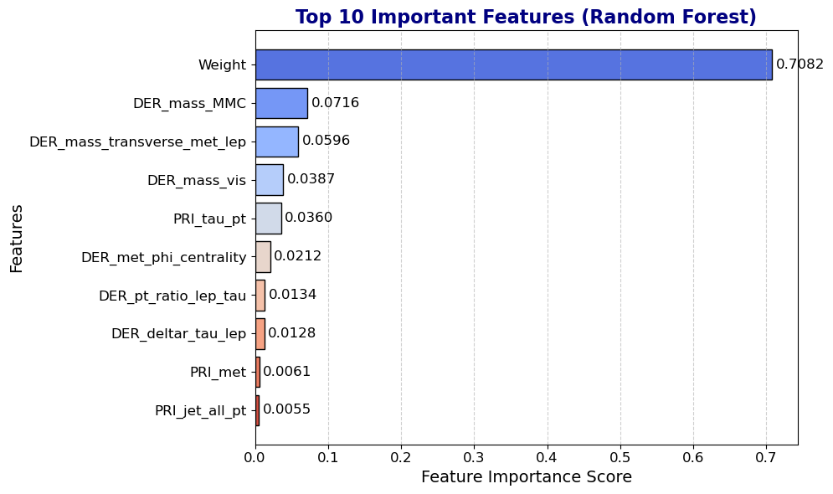

Slide 18
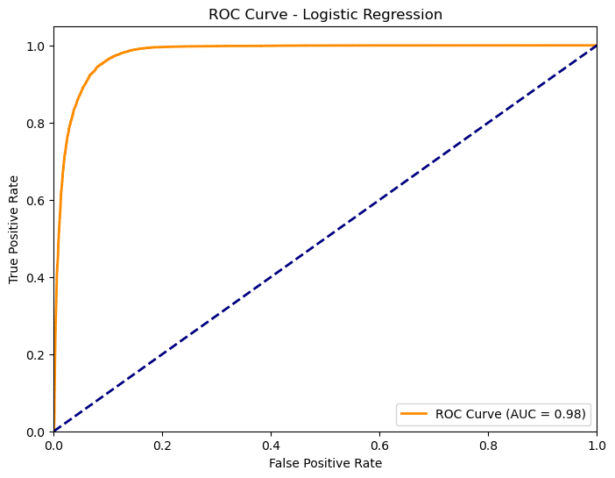
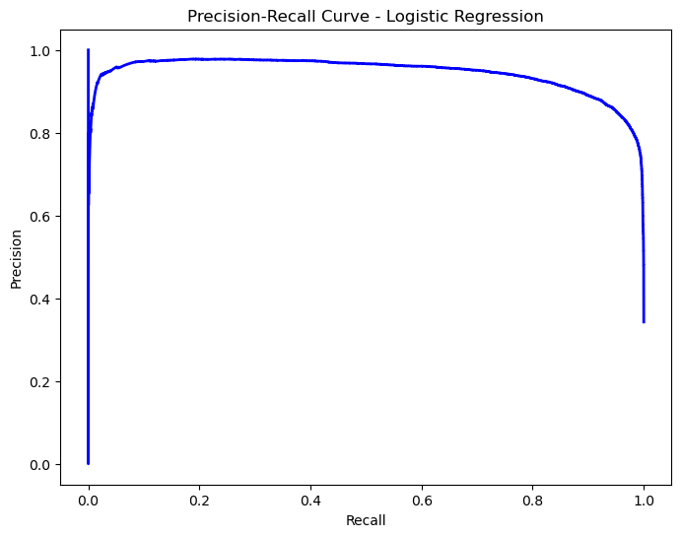
Model Training and Evaluation
Model 1: Logistic Regression Training and Evaluation
Model: Logistic Regression
Performance:
Cross Validation Accuracy: 0.985
Confusion Matrix:
True Positives (Signal): 28,107
True Negatives (Background): 22,896
Classification Report:
Precision: 0.87 (for Signal), 0.96 (for Background)
Recall: 0.95 (for Signal), 0.86 (for Background)
F1-Score: 0.91 (for Signal), 0.91 (for Background)
Overall Metrics:
Accuracy Score: 0.9859
ROC AUC Score: 0.9370
Receiver Operating Characteristic

Slide 19
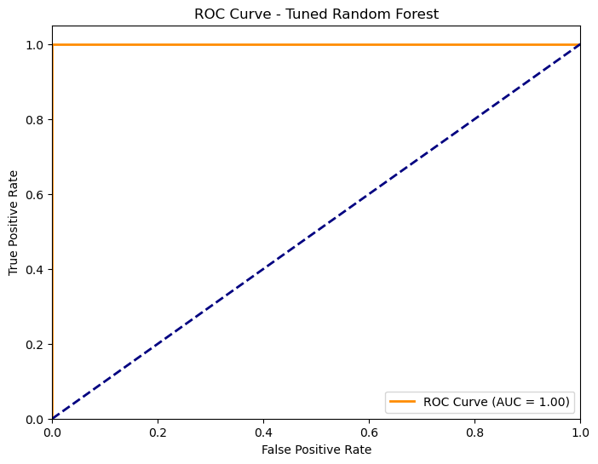
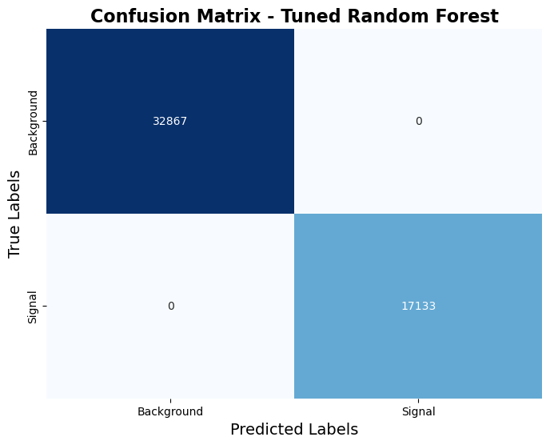
Model Training and Evaluation
Model 2: Random Forest Training and Evaluation (Tuned)
Model: Random Forest Classifier (Tuned)
Performance:
Cross Validation Accuracy: 0.999
Confusion Matrix:
True Positives (Signal): 26,273
True Negatives (Background): 26,235
Classification Report:
Precision: 1.00 for both classes
Recall: 1.00 for both classes
F1-Score: 1.00 for both classes
Overall Metrics:
Accuracy Score: 1.0
ROC AUC Score: 1.0

Slide 20
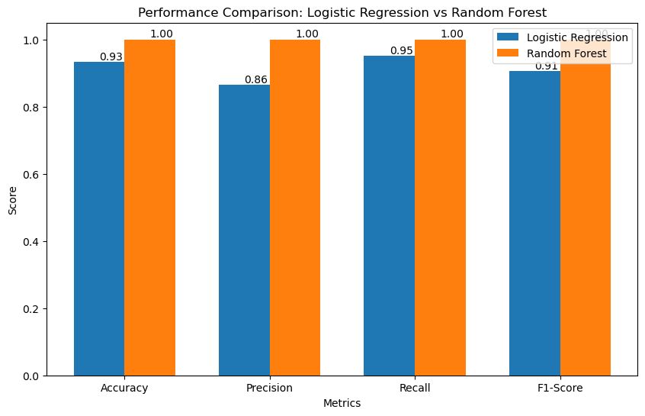
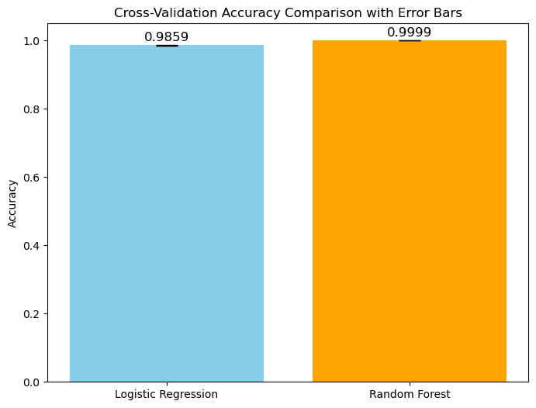
Comparison of Models and Insights
Comparison of Logistic Regression and Random Forest:
Logistic Regression had slightly lower recall on the background class, whereas Random Forest achieved perfect classification.
Logistic Regression is better suited for linear relationships, while Random Forest excels at capturing complex, non-linear patterns.

Slide 21
Conclusion and Recommendations
Key Findings:
Model Performance:
Random Forest Model: Achieved perfect classification with an accuracy, precision, recall, and ROC AUC score of 1.000.
Logistic Regression Model: Although Logistic Regression also performed well (accuracy of 0.9859 and ROC AUC of 0.9370), it struggled with complex non-linear patterns, showing slightly lower recall for background events.
Feature Importance:
In both models, key features such as Weight, DER_mass_MMC, and DER_mass_transverse_met_lep were critical in predicting event types.
Random Forest better captured the nuanced interactions between these features, leading to better overall performance

Slide 22
Recommendations:
1. For Researchers:
Targeted Experiments: Focus on features like Weight and DER_mass_MMC that both models found important.
Feature Engineering: Future efforts could explore more advanced interactions or non-linear transformations to further enhance the Logistic Regression model.
2. For Model Deployment:
The Random Forest model is ideal for real-time classification due to its high accuracy.
Logistic Regression can still be useful in cases where model interpretability is key.
3. Continuous Monitoring and Updates:
Both models should be monitored over time to ensure robustness in diverse datasets and experimental conditions.
4. Exploring Other Models:
While Random Forest delivered the best performance, testing other models like Gradient Boosting or Neural Networks could reveal additional insights. Logistic Regression can act as a baseline model for comparison.
Future research can focus on more complex feature interactions. The addition of polynomial features or interaction terms could further enhance Logistic Regression and improve its ability to model non-linear relationships.
By leveraging the insights from this predictive model, researchers in particle physics can enhance the identification and analysis of significant events, contributing to a deeper understanding of fundamental particles and their interactions.

Slide 23


